Slide 1

On the utility of Gradient Compression in Distributed Training Systems
Saurabh Agarwal

Slide 2



Collaborators
Hongyi Wang
UW-Madison
Shivaram Venkatraman
UW-Madison
Dimitris Papailiopoulos
UW-Madison

Slide 3





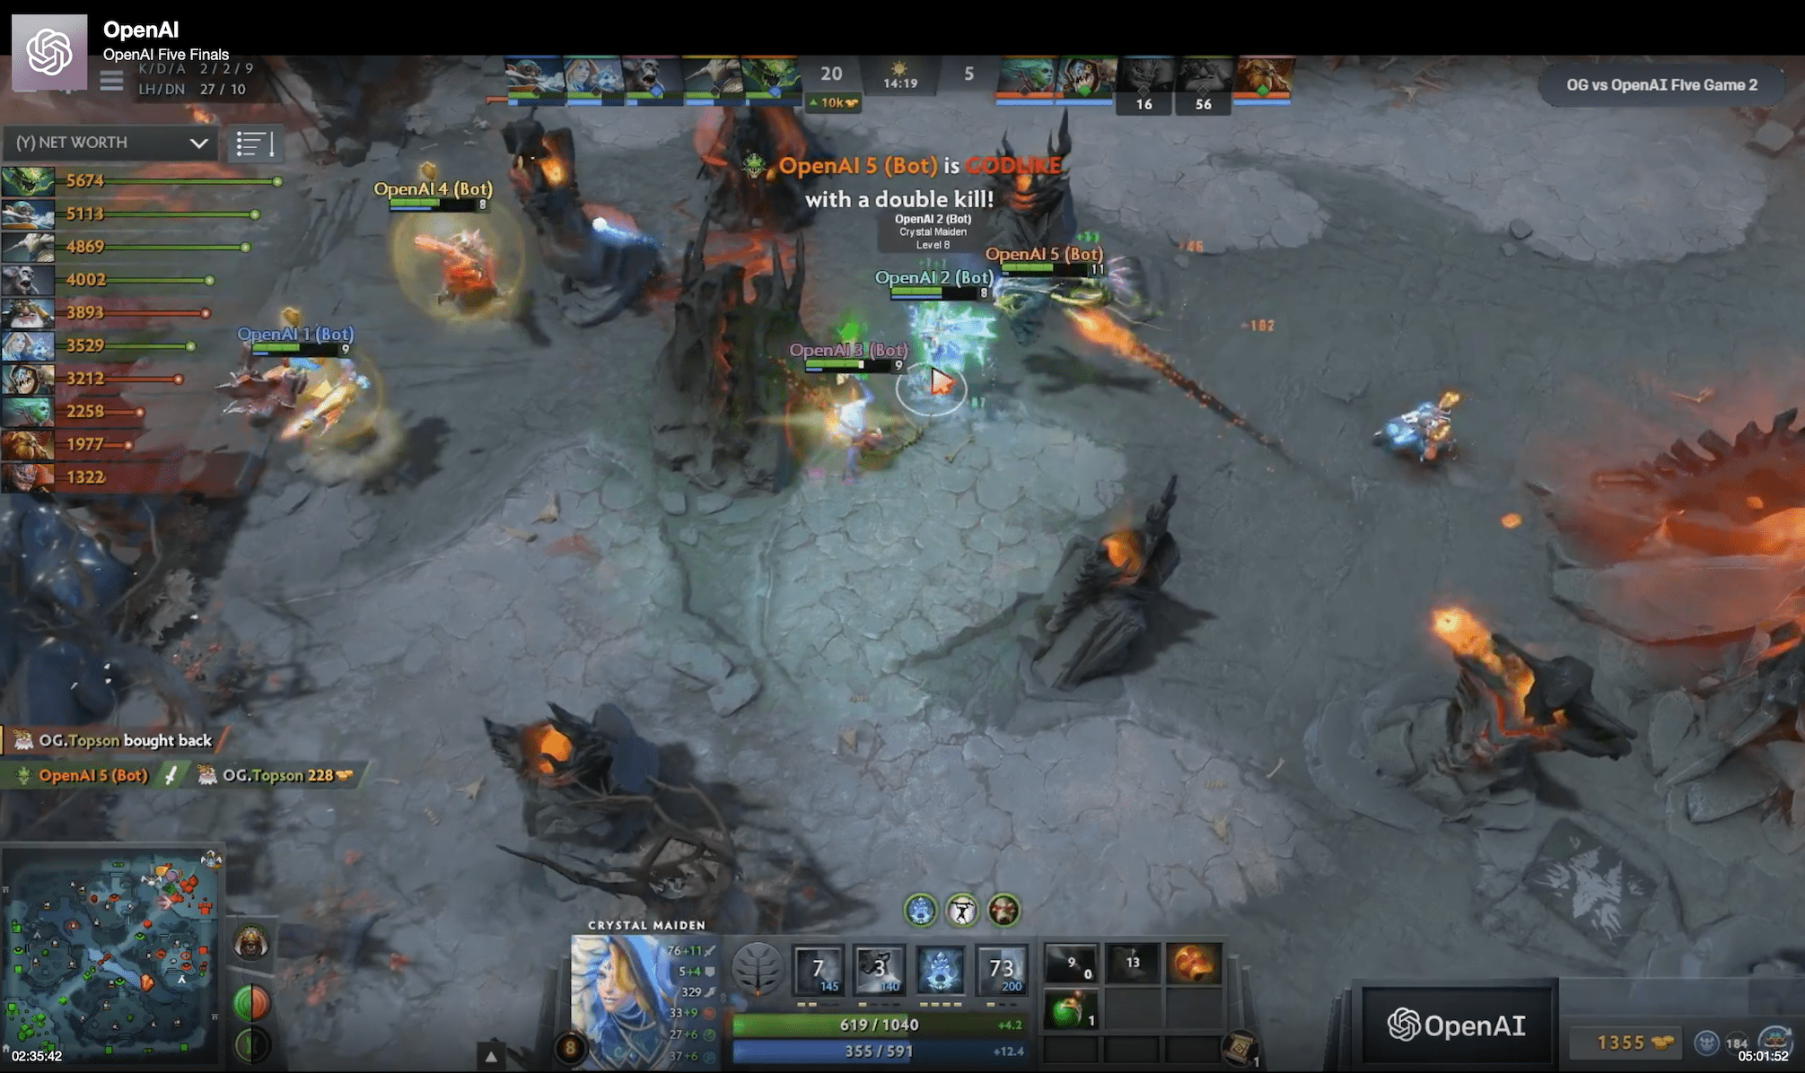

Deep Neural Networks consistently achieve state of the art results across several domains
Image Classification
Speech to Text
Game Playing

Slide 4
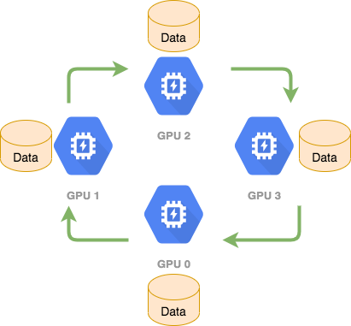

Distributed Training: Data Parallelism
Each GPU has its own replica of the model.
Replicas run in lock step, requiring gradient synchronization gradients at each step
Gradient Synchronization
communication overhead
Several prior works have identified and tried to reduce this communication overhead.

Slide 5
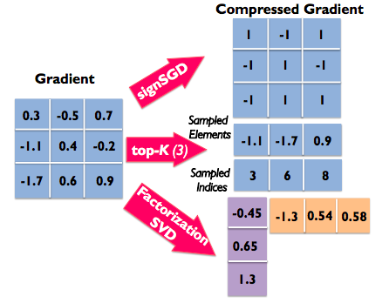
Reducing communication overhead?
Machine Learning approaches -
Gradient Compression

Slide 6
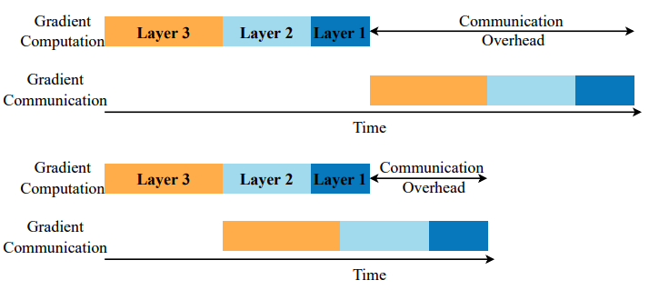
Reducing communication overhead?
System approaches -
Faster Synchronizing Primitives – NCCL all-reduce ..
Overlapping gradient synchronization with computation

Slide 7
Questions we aim to answer
Do gradient compression techniques benefit from system optimization techniques ?
Does gradient compression provide reduction in training time in standard training setups ?
Under what conditions do gradient compression methods provide speedups over off the shelf system libraries ?

Slide 8
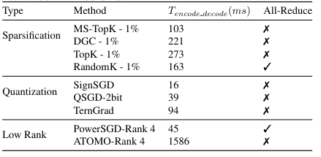
Methodology

Slide 9

Methodology
Used Distributed Data Parallel Module(DDP)
An of the shelf library
Scaled our experiments upto 96 GPUs
Used the most optimized implementations

Slide 10
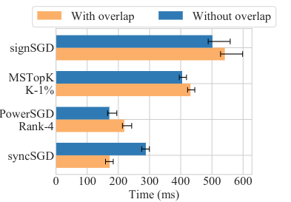
Overlapping gradient compression ?
Overlapping Gradient Compression with computation deteriorates training time

Slide 11
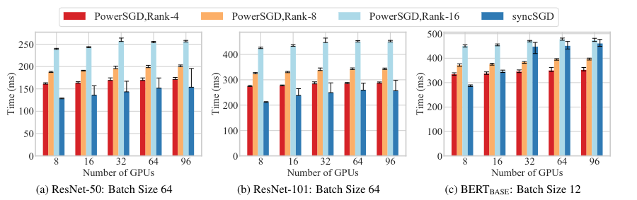
Does Gradient Compression provide speedups?
Only in 6 cases out of more than 200 configurations gradient compression provides speedup when bandwidth is ~10Gbps

Slide 12
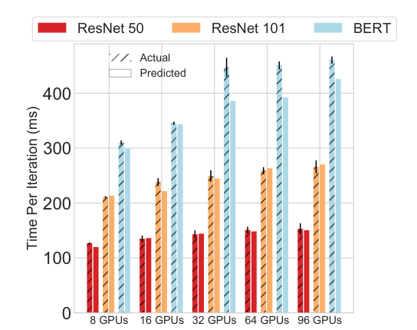
Setups in which Gradient Compression provides speedups ?
To study this we created an analytical performance model which closely tracks the performance of actual experiments

Slide 13
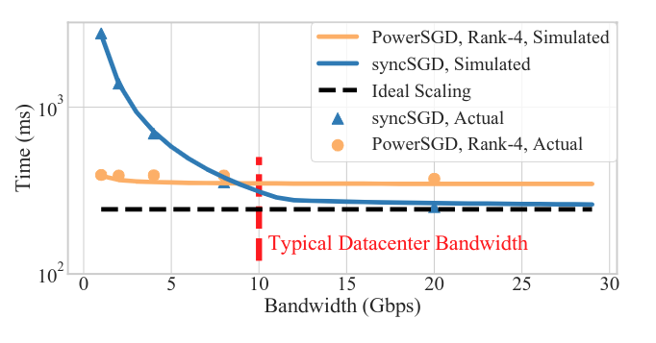
Setups in which Gradient Compression provides speedups ?
Effect of bandwidth on iteration time

Slide 14
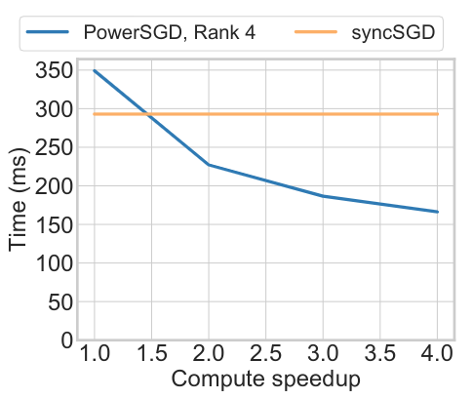
Setups in which gradient compression provides speedups ?
Assuming compute increases but network bandwidth remains constant

Slide 15
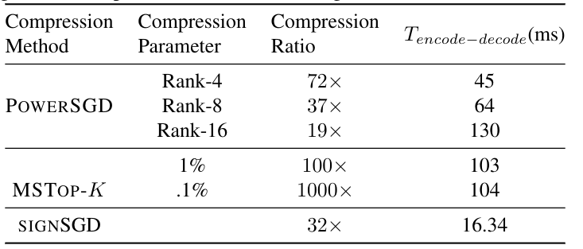
Why does Gradient Compression not provide speedup ?
System optimizations drastically reduce the observed time for gradient synchronization
Gradient Compression methods spend a lot of extra compute performing compression and decompression

Slide 16
Conclusion
Existing compression methods provide little speedup in typical
data-center setting
To provide actual speedups gradient compression methods need to focus less on compression and more on reducing encode-decode time

Slide 17
More Details –
https://arxiv.org/abs/2103.00543`

